Slide 1


Agentic RAG Chatbot
Multi-Format Document QA with Model Context Protocol
Developed by: Chakrika Guttameedi
For: SLRI Solutions, LLC
Advanced AI/ML Project implementing cutting-edge agentic architecture

Slide 2





CoordinatorAgent
Agent-Based Architecture with MCP Integration
System Architecture Flow
CoordinatorAgent
Orchestrates pipeline & manages agent interactions
→
IngestionAgent
Parses multi-format documents & creates chunks
RetrievalAgent
→
FAISS vector store & semantic search
→
LLMResponseAgent
Gemini 2.0 Flash response generation
{
"sender": "RetrievalAgent", "receiver": "LLMResponseAgent", "type": "CONTEXT_RESPONSE",
"trace_id": "rag-457", "payload": {
"retrieved_context": ["slide 3: revenue up", "doc: Q1 summary..."], "query": "What KPIs were tracked in Q1?"
}
}

Slide 3


System Workflow & Data Flow
1. Document Upload & Processing
Multi-format support: PDF, PPTX, DOCX, CSV, TXT/MD with
intelligent parsing and chunking strategies
2. Vector Embeddings & Storage
SentenceTransformers (all- MiniLM-L6-v2) with FAISS vector database for high-performance semantic search
3. MCP-Based Agent Communication
Structured message passing with trace IDs for complete
observability and debugging
4. Contextual Response Generation
Gemini 2.0 Flash LLM with retrieved context for accurate, source-attributed answers
Real-time Processing: Live status updates during document ingestion
Multi-turn Conversations: Maintains chat history and context
Source Attribution: Every answer linked to specific document sections
Error Handling: Robust error management across all agents

Slide 4

F rontend & UI
Technology Stack & Implementation
AI & Language Models
Google Gemini 2.0 Flash: Advanced LLM for contextual response
generation with high accuracy
Streamlit: Interactive web interface with drag-and-drop uploads, real- time chat, and system monitoring
Vector Database
FAISS: High-performance similarity
search with optimized indexing for real-time retrieval
Document Processing
Multi-library approach: PyPDF2, python-docx, python-pptx, pandas for comprehensive format support
Architecture
Custom MCP Protocol: Structured agent communication with trace tracking and error handling
Embeddings
SentenceTransformers: all-MiniLM- L6-v2 model for semantic understanding and vector
generation

Slide 5

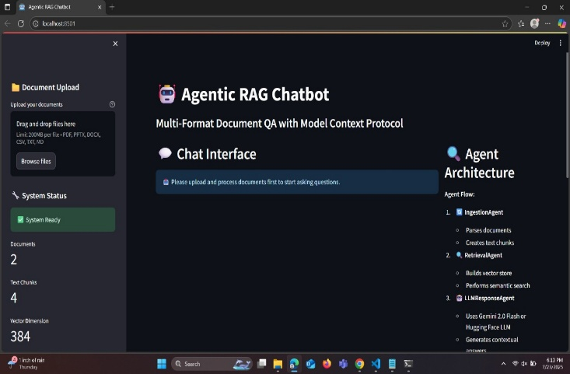
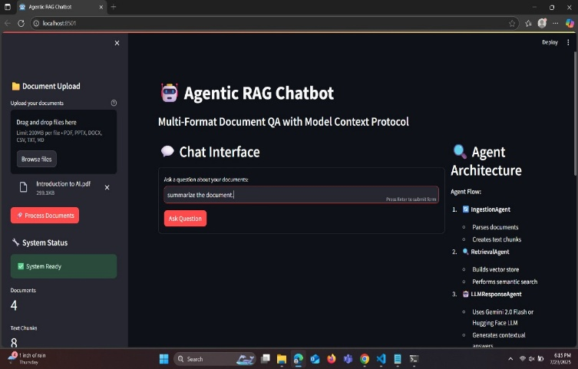
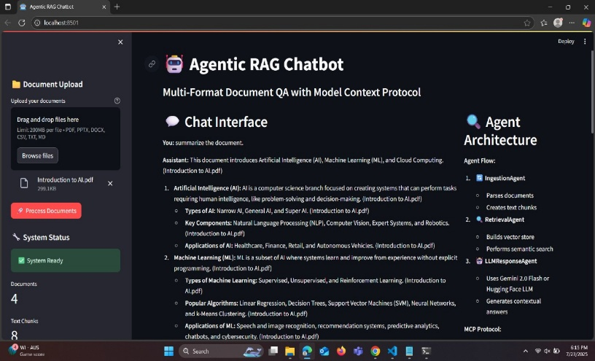
Main Dashboard
Application Interface & User Experience
Document Processing
Clean interface with document upload, agent architecture view, and system status monitoring
Multi-format upload with real-time processing status and chunk generation
Intelligent Chat
Contextual responses with source attribution and multi- turn conversation support
"Built with user experience in mind - intuitive interface meets powerful AI capabilities"

Slide 6



Development Journey & Future Vision
Technical Challenges Overcome
Multi-format document parsing with consistent chunking strategies
Designing efficient MCP-based agent communication protocol
Optimizing FAISS vector store for real-time performance
Implementing robust error handling across distributed agents
Memory management for large document processing
Future Enhancements
Persistent chat history with database integration
Advanced semantic chunking with document structure awareness
Multi-language document support and processing
Enhanced security with user authentication and encryption
Distributed agent architecture for enterprise scalability
Project Impact
Successfully demonstrated proficiency in advanced AI/ML concepts , system architecture design , and full-stack development while delivering a production-ready solution with comprehensive documentation.

